Slide 1
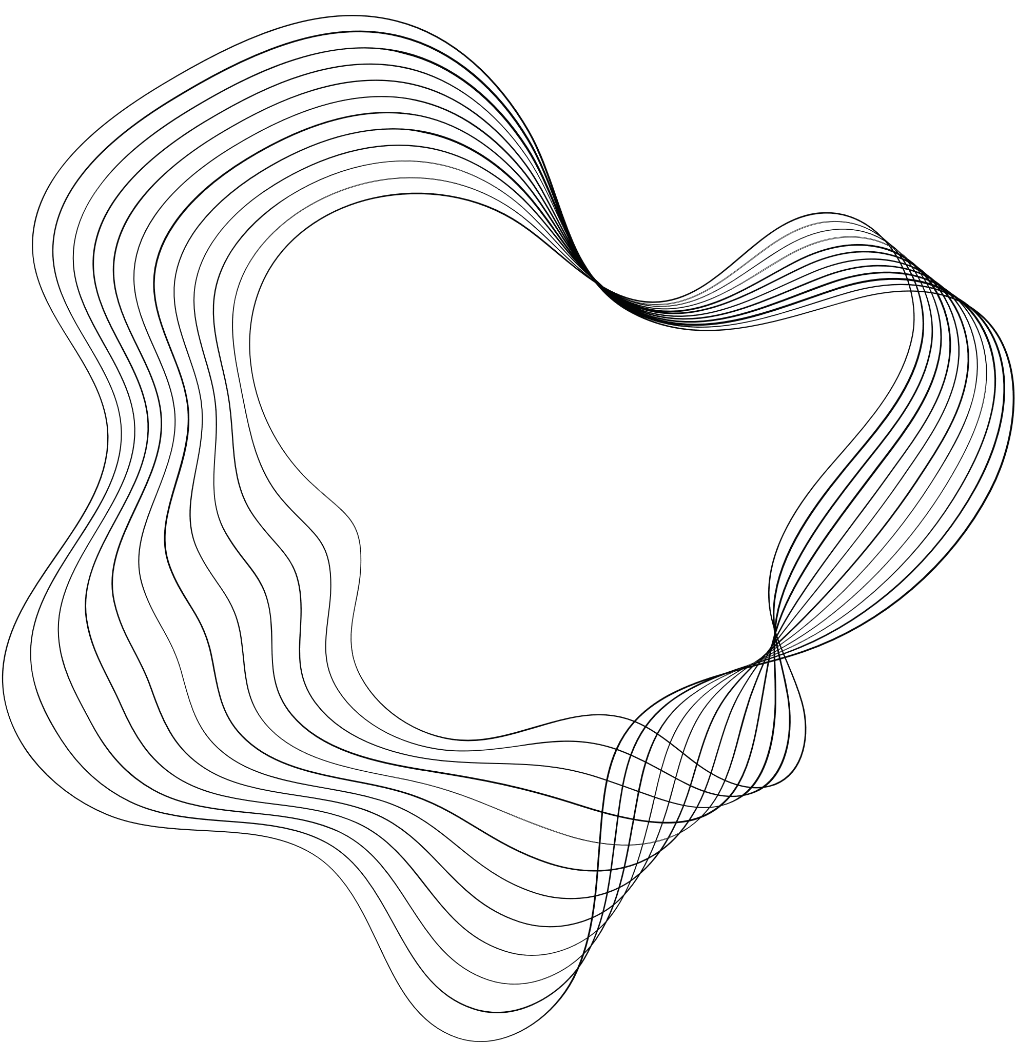

FAST&STEREOSCOPIC
IMAGING
BY D.DARAZI
G. Antar, O. Ichtiyak, G. Sabbagh, D. Darazi

Slide 2

OUTLINE
01
MOTIVATION
02
FAST IMAGING
CAMERA SETUP & TRIGGERING
Video assembly
03
STEREOSCOPIC IMAGING
MATHEMATICAL BASIS
DEVICE DESIGN & RESULTS
04
Conclusion
05
Future Prospects

Slide 3

Motivation
In tokamaks, the presence of dust, flakes, and unidentified flying objects (UFOs) in the plasma flow can have significant implications for both the operation and safety of the reactor.
Dust in a tokamak can come from various sources, including the erosion of plasma-facing components, deposition of impurities, and material sputtering from the walls. Its impacts include: Plasma Contamination, Safety Concerns, Diagnostics Interference.
Flakes are typically larger particles that can originate from the delamination or spalling of coatings or from larger pieces of eroded material from the walls and components.
UFOs refer to any unidentified objects observed within the plasma that cannot be immediately classified as dust or flakes. Their biggest impact is unpredictability.

Slide 4
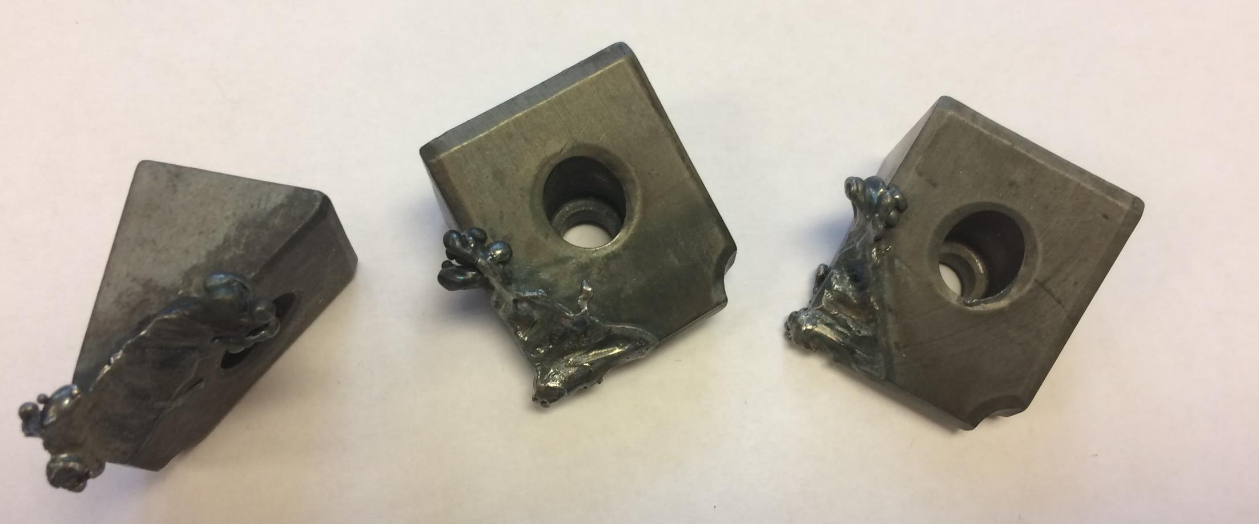
Motivation
Melted Molybdenum tiles from Alcator C-Mod due to UFO disruptions.

Slide 5
Motivation
Issue n° 1
Particles in the plasma
Issue n° 2
These particles move at high speeds. We need high-speed imaging. And these cameras are very expensive.
In order to predict the effect of dust particles, flakes or UFOs in the plasma, we must first determine their three-dimensional position, their size, and velocity.
.
The position. size and velocity of these particles should enable us to determine whether to interrupt the plasma BEFORE a disruption takes place

Slide 6
Motivation
Our approach is to perform high-speed stereoscopic imaging of the plasma It has two components: 1- High speed imaging 2- stereoscopic detection

Slide 7
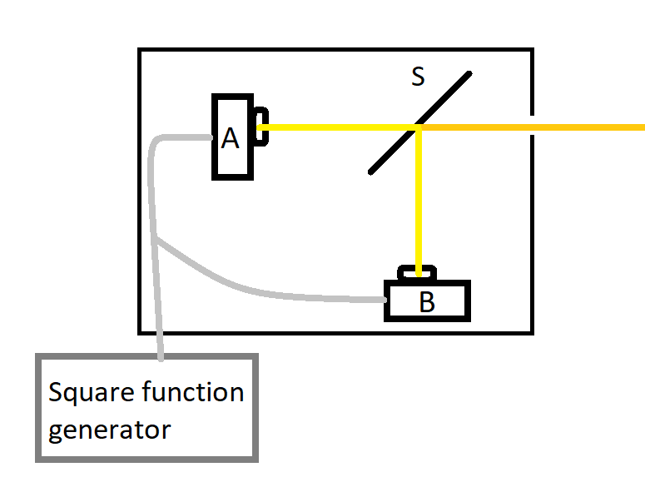

STEP 1: Fast Imaging
CAMERA SETUP & triggering
We are using two cameras that can reach a maximum frame rate of 10 kHz with a shutter time down to 1 μs each.
The light beam is split into two identical beams each traveling towards a camera, granting them the same field of view.

Slide 8
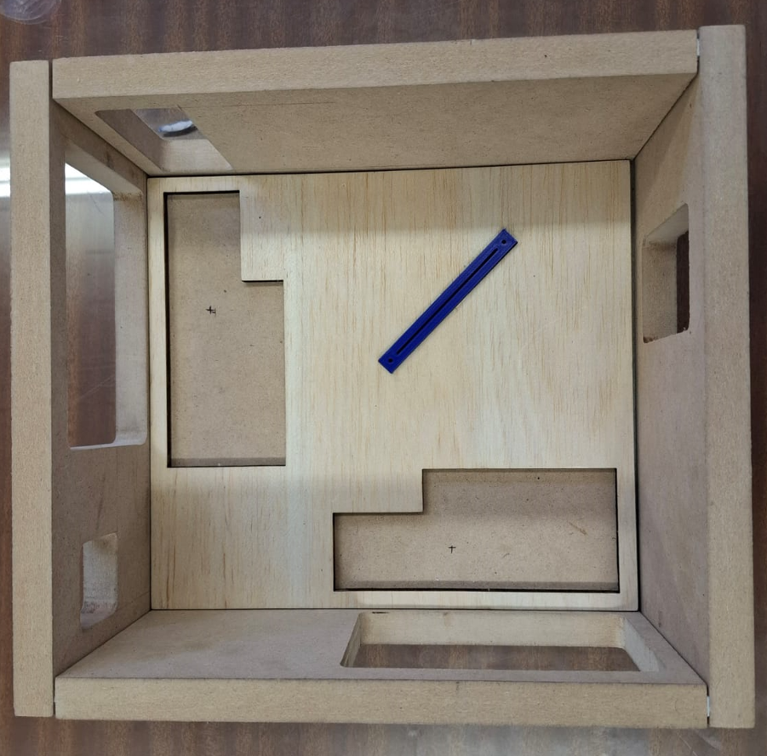
STEP 1: Fast Imaging
CAMERA SETUP

Slide 9
Fast Imaging triggering
The trigger time is set by the function generator but the integration (exposure) time is set in the camera

Slide 10
Fast Imaging triggering
Triggering camera 1 on positive slope and camera 2 on negative slope.
Hardware needed, a function generator where the duration of the pulse is set independently from the time between pulses
Camera 1
Triggered
On
Positive slope
Camera 2
Triggered
On
Negative slope

Slide 11
Fast Imaging triggering
…
Camera 1
OPEN
CLOSED
…
Camera 2
CLOSED
OPEN
CLOSED

Slide 12
Fast Imaging triggering
…
Camera 1
CLOSED
OPEN
CLOSED
OPEN
…
Camera 2
CLOSED
OPEN
CLOSED
OPEN

Slide 13

Fast Imaging
Video assembly
The video is recorded as a series of pictures from cameras A and B.
Camera A’s images are taken as is, while camera B’s images are mirrored. Due to the light being reflected off of the beam splitter the images are flipped.
The pictures are then ordered so that the frames alternate between pictures taken from camera A and pictures of camera B
A code was written in order to achieve this.

Slide 14

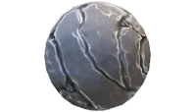
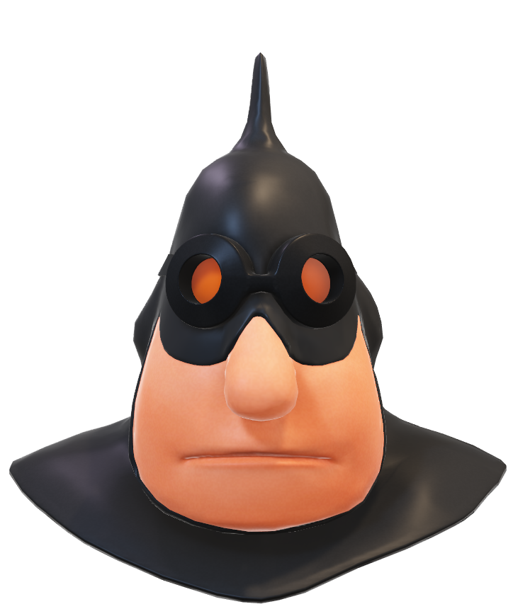
STEP 2: Stereoscopic detection
MATHEMATICAL BASIS
The Challenge is to determine the position of a point in three dimensions

Slide 15
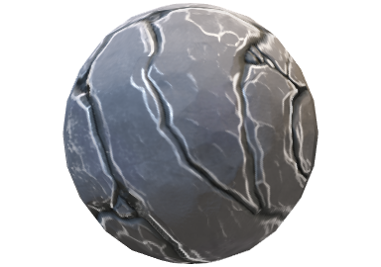
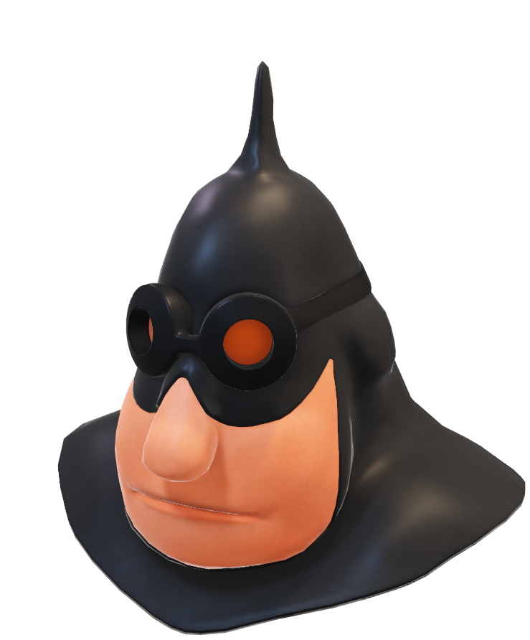
STEP 2: Stereoscopic detection
MATHEMATICAL BASIS

Slide 16
STEP 2: Stereoscopic detection
MATHEMATICAL BASIS

Slide 17
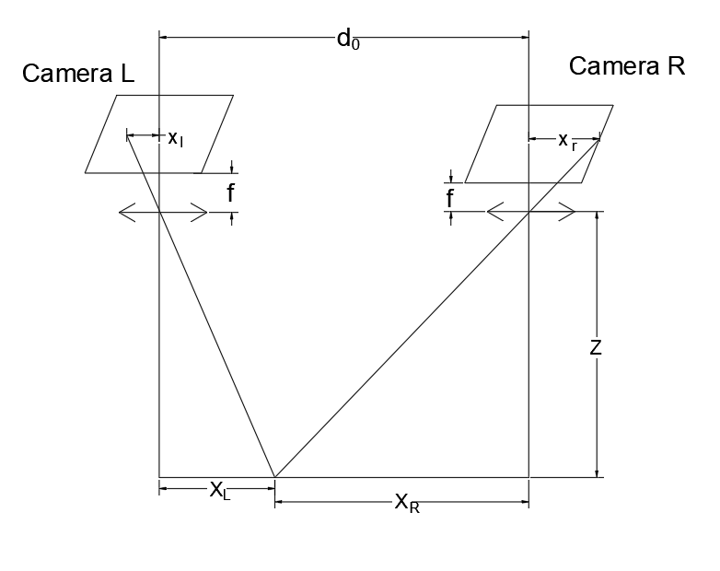
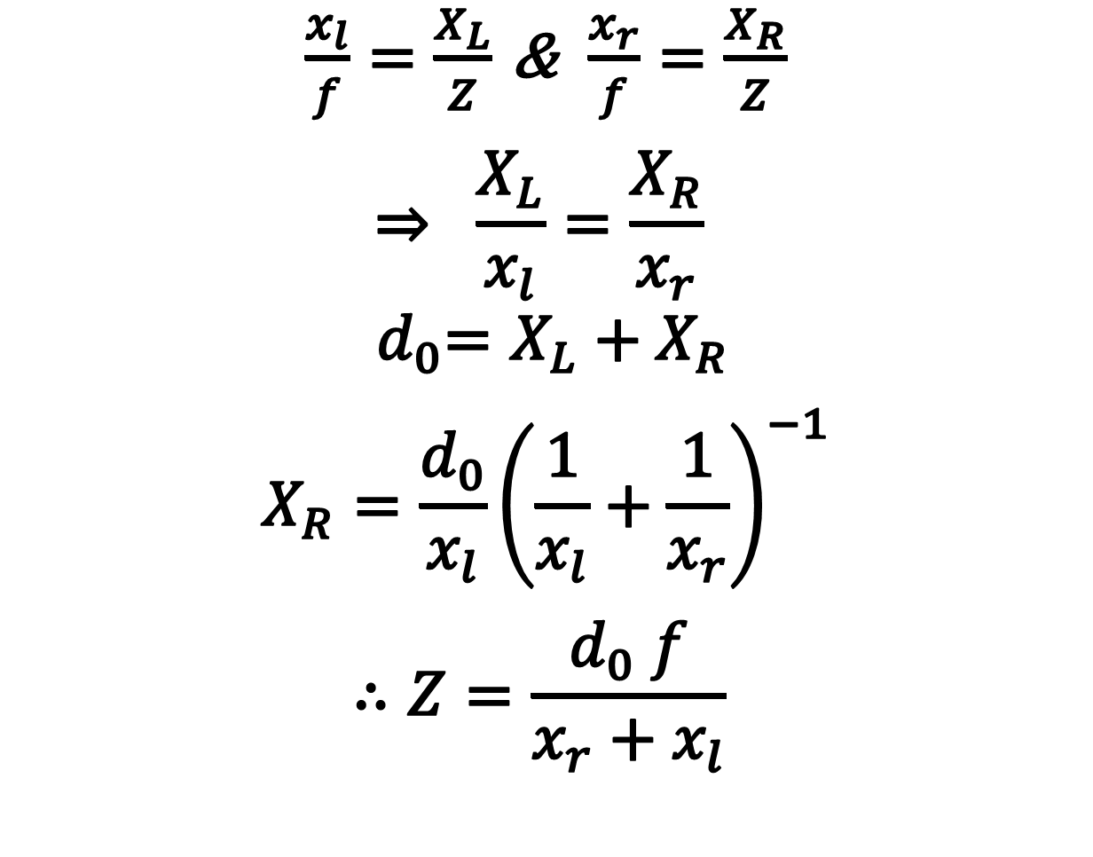
STEP 2: Stereoscopic detection
MATHEMATICAL BASIS
$\frac{x_{l}}{f}=\frac{X_{L}}{Z}$ & $\frac{x_{r}}{f}=\frac{X_{R}}{Z}$
$$⇒ \frac{X_{L}}{x_{l}}=\frac{X_{R}}{x_{r}}$$
$${ d}_{0}=X_{L}+X_{R}$$
$$X_{R}=\frac{d_{0}}{x_{l}}{\left(\frac{1}{x_{l}}+\frac{1}{x_{r}}\right)}^{−1}$$
$$∴Z=\frac{d_{0} f}{x_{r}+x_{l}}$$

Slide 18
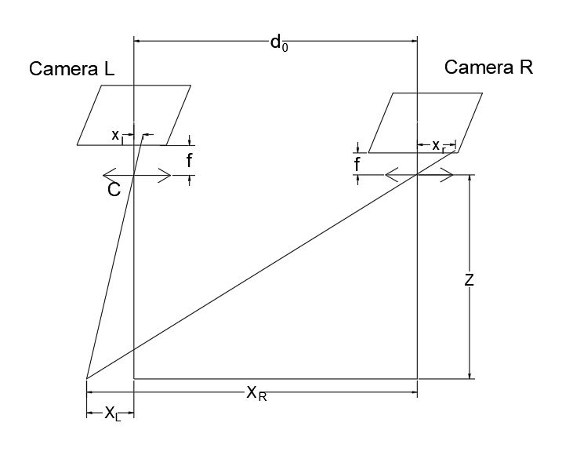
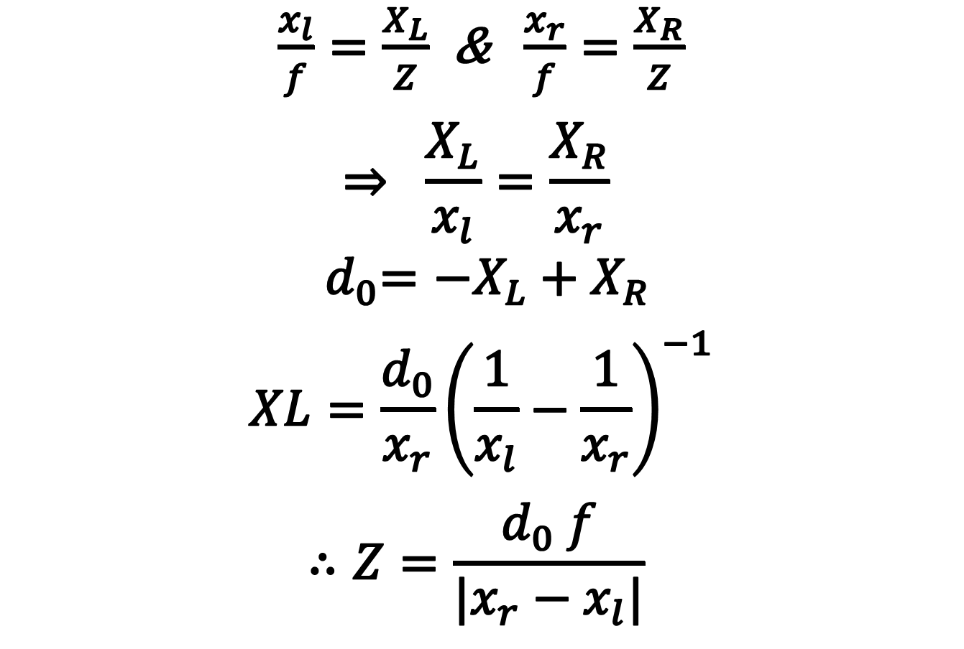
STEP 2: Stereoscopic detection
MATHEMATICAL BASIS
$\frac{x_{l}}{f}=\frac{X_{L}}{Z}$ & $\frac{x_{r}}{f}=\frac{X_{R}}{Z}$
$$⇒ \frac{X_{L}}{x_{l}}=\frac{X_{R}}{x_{r}}$$
$${ d}_{0}=−X_{L}+X_{R}$$
$$XL=\frac{d_{0}}{x_{r}}{\left(\frac{1}{x_{l}}−\frac{1}{x_{r}}\right)}^{−1}$$
$$∴Z=\frac{d_{0} f}{|x_{r}−x_{l}|}$$
Valid for $X_{L}>X_{R}$ due to the absolute value $|x_{r}−x_{l}|$

Slide 19
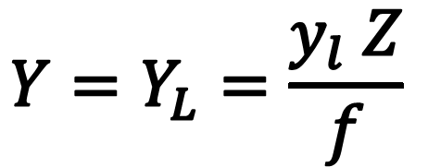
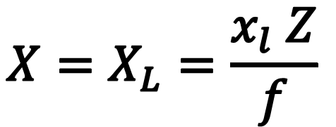
STEP 2: Stereoscopic detection
MATHEMATICAL BASIS
X coordinate w.r.t camera L
Similarly the Y coordinate is
$$X=X_{L}=\frac{x_{l} Z}{f}$$
$$Y=Y_{L}=\frac{y_{l} Z}{f}$$
$$Z=\frac{d_{0} f}{|x_{r}±x_{l}|}$$

Slide 20
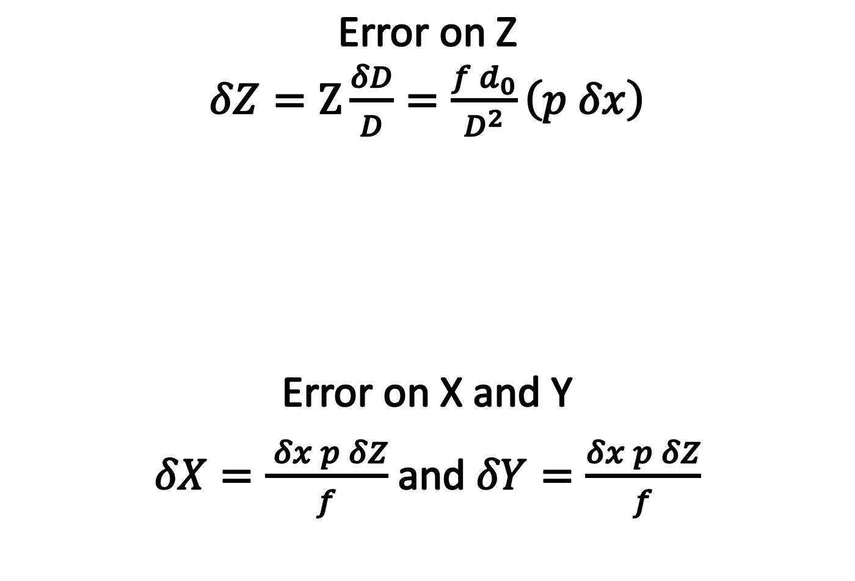
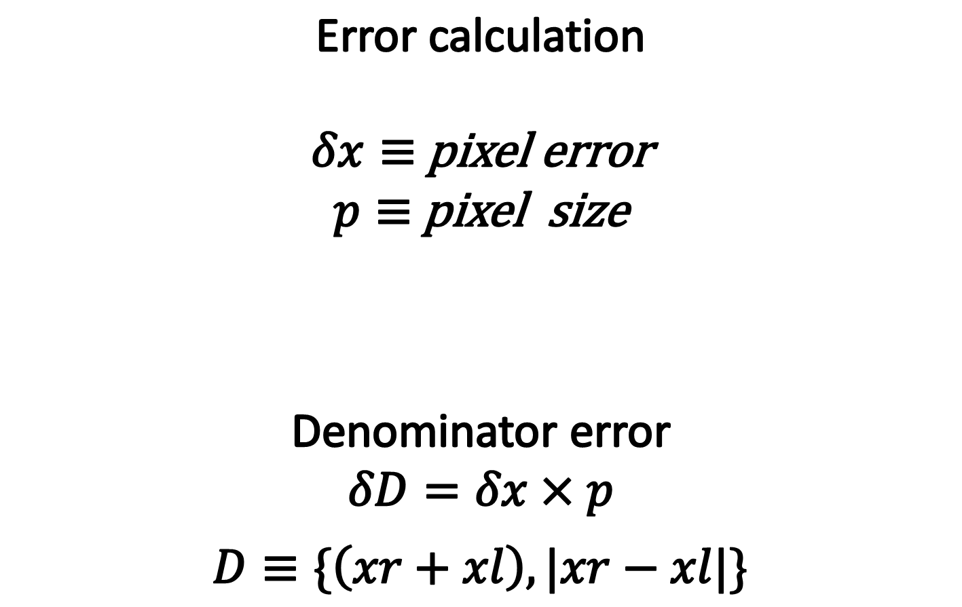
STEP 2: Stereoscopic detection
MATHEMATICAL BASIS
Error calculation
$δx≡$ pixel error
$p≡$ pixel size
Denominator error
$δD=δx×p$
$D≡\{\left(xr+xl\right), |xr−xl|\}$
Error on Z
$δZ=Z\frac{δD}{D}=\frac{f d_{0}}{D^{2}}\left(p δx\right)$
Error on X and Y
$δX=\frac{ δx p δZ}{f}$ and $δY=\frac{δx p δZ}{f}$

Slide 21

Stereoscopic Detection
DEVICE DESIGN & RESULTS

Slide 22

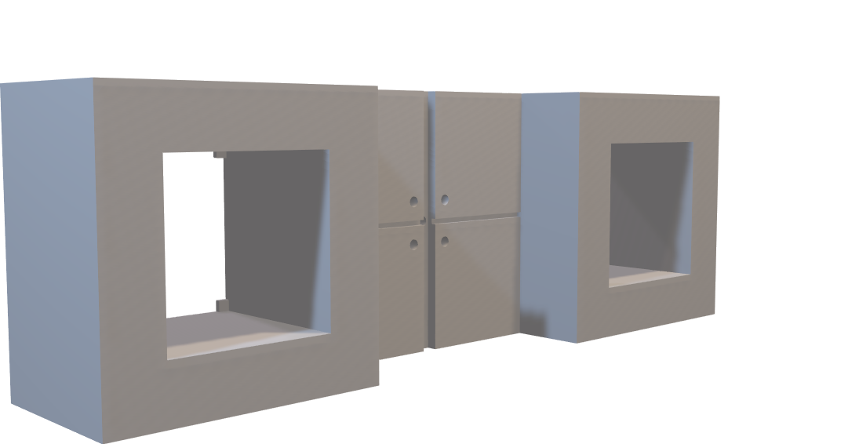
Stereoscopic Detection
DEVICE DESIGN & RESULTS
The camera holder fixes the cameras 10cm apart. Which is the $d_{0}$ value discussed earlier.

Slide 23
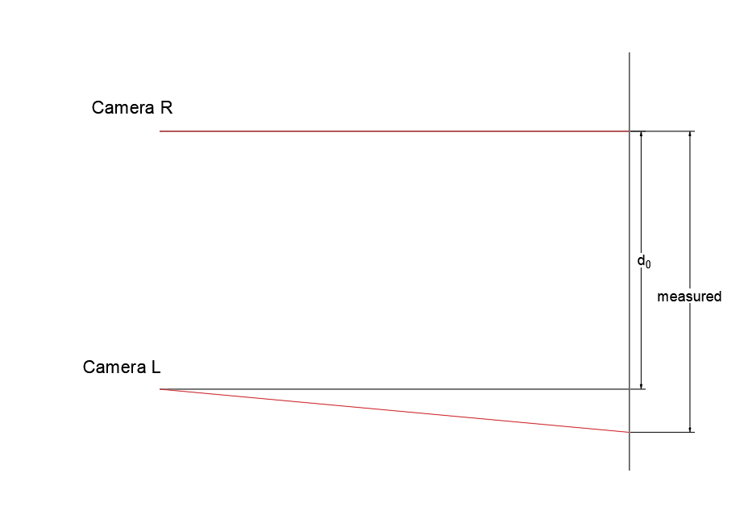
Stereoscopic Detection
DEVICE DESIGN & RESULTS

Slide 24
Stereoscopic Detection
DEVICE DESIGN & RESULTS
The flaw must have arose from sanding the holder in an attempt to fix a printing error. We are currently working on fixing the design and reprinting it in hopes of fixing the problem

Slide 25
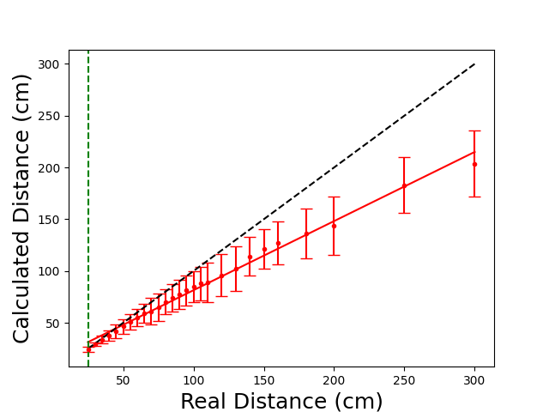
Stereoscopic Detection
DEVICE DESIGN & RESULTS

Slide 26
Conclusion
The fast imaging technique allows us to fix the first problem and be able to detect the fast moving dust particle in the plasma flow.
Combined with the stereoscopic imaging we gain the ability to determine the size, position and velocity of large particles , which can cause major disruptions thus affecting the lifetime of fusion devices. We then assess the severity of the situation and act accordingly.

Slide 27
Future Prospects
Finding another technique that will increase the frame rate even more using the same cameras.
Find a way to calibrate the stereoscopic data to account for the cameras not being perfectly parallel.
Develop object recognition software to auto-detect and recognize UFOs.

